Slide 1
Neural Networks

Slide 2
Artificial Neural Network
Mimics the Parallel interconnections, that exist between the neurons of the brain.
Synaptic connection strengths among neurons are used to store the acquired knowledge.
1 op 10^-9: processor vs 10^-3: neuron. Yet neurons are faster for complex tasks such as: Face recognition, natural speech.
Why? The network is massively parallel.

Slide 3
Artificial Neural Network
Neural Network: Set of simple, analog signal processors connected by links, where each link has a numeric weight.
It resembles the brain in two respects:
Knowledge is acquired by the network from its environment through a learning process
Synaptic connection strengths among neurons are used to store the acquired knowledge.

Slide 4
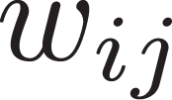
O_1
O_2
O_n
Output Layer
Slab or Layer
Neuron i
I_1
I_2
I_n
Input Layer

Slide 5
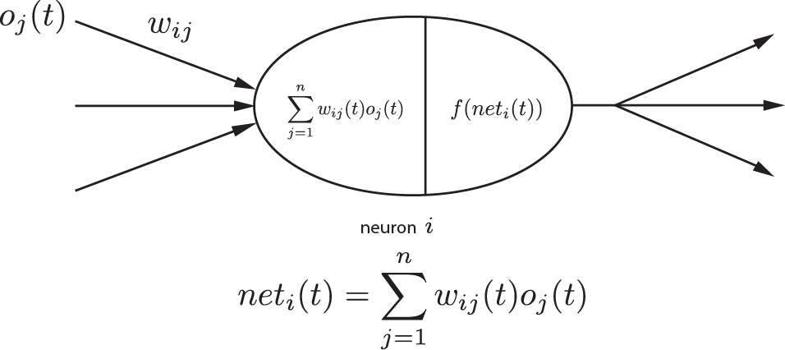
Activation function
Input from another
neuron j or source
Weight associated
To link
Is the function f non-linear?
Activation value is
Then propagated
The input is modulated by the weight

Slide 6
Each unit receives stimulation from other units, except the input layer.
The signal received is modulated by the weighting value of the connection.
The modulated inputs are then integrated. (summed)

Slide 7
An activation value is calculated with an activation function, which takes the sum of the inputs.
The activation value is then propagated to other neurons.
This activation function can be of different types.

Slide 8
Vector talk, I don’t understand.
Net_i = o * w_i
||o||||W_i|| * cos(theta)
Inner Product == Dot Product?
Inner product of a and b, is the projection
Of a on b
a
b

Slide 9
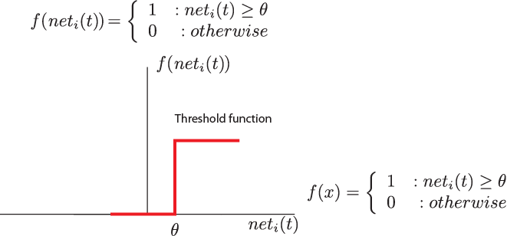
Threshold Function
1
0
Hard Limited output
Only two possible outputs 0 or 1
= 0.4
0.0
0.2
0.3
-0.2

Slide 10
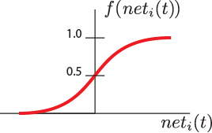
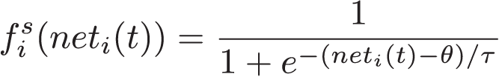

Sigmoid Function
Two stable states with a transition region.
Mathematically continuous
Many possible functions.

Slide 11
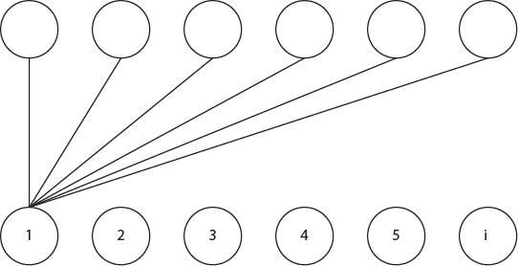

Competitive function
Outstar:
Only 2 states (active, inactive)
When active it transmits a memory pattern
When inactive, it transmits nothing
Instar:
Excited only by specific input patterns
They compete among themselves.

Slide 12
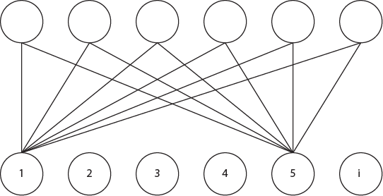
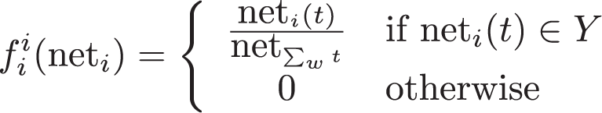
Interpolation Function

Slide 13
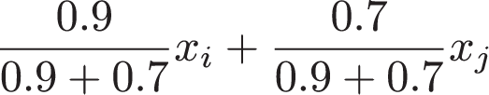


Slide 14
Gaussian Function
Acts as a …

Slide 15
O1
Output layer
0.6
-0.8
H1
H2
Feature detectors
0.7
0.3
0.6
0.4
I1
I2
Filters for input signals
How do they arrive to this?
O(t) = (I1(t-2)+I2(t-2))*~(I1(t-2)*I2(t-2))

Slide 16
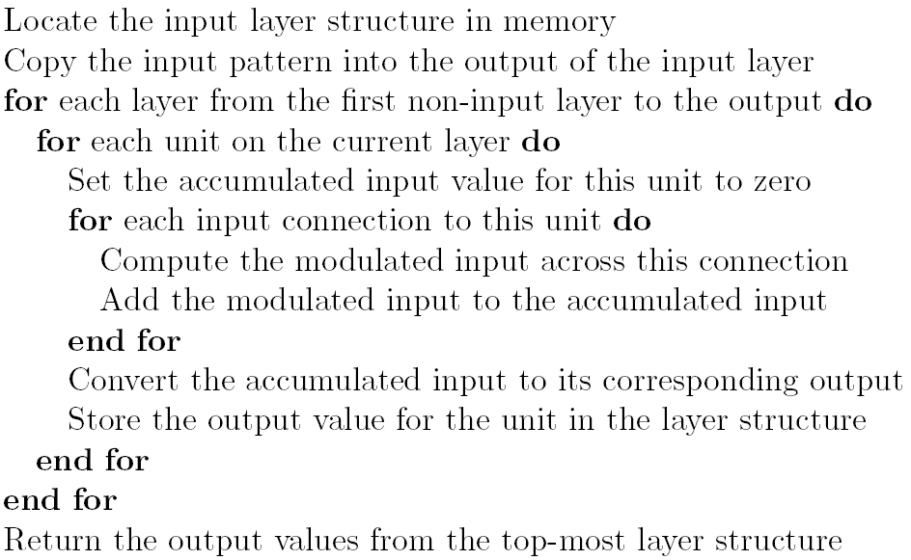
Algorithm

